Slide 1
SOFTWARE DEVELOPMENT PROJECT MANAGEMENT (CSC4125)
Lecture 8: Risk Management

Slide 2
Some definitions of Risk
‘The chance of exposure to the adverse consequences of future events’ – PRINCE 2
‘An uncertain event or condition that, if it occurs, has a positive or negative effect on a project’s objectives’ – PM-BOK
Project plans have to be based on assumptions
Risk is the possibility that an assumption is wrong
When the risk happens it becomes a problem or an issue
Key elements of Risk
It relates to the future
It involves cause and effect

Slide 3
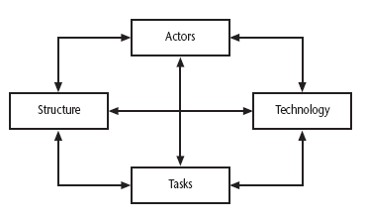
Categories of risk

Slide 4
Categories of risk
This is based on Lyytinen’s sociotechnical model of risk
Actors –relate to all those involved in the project including both developers, users and managers e.g. a risk could be that high staff turnover leads to information of importance to the project being lost
Technology – both that used to implement the project and that embedded in the project deliverables – risk could be that the technologies selected are not in fact appropriate.
Structure – describes the management structures and systems, including those affecting planning and control. For example, the implementation might need user participation in some tasks, but the responsibility for managing the users’ contribution might not be clearly allocated.
Tasks – the work to be carried out. A typical risk is that the amount of effort needed to carry out the task is underestimated.
Note: A risk could be well belong to more than one of the four areas – for example, estimates being wrong could be influenced by problems with actors (e.g. lack of experience with a technical domain) or the structure (over optimism of managers keen to win work).

Slide 5
Overview
Project risks are those that could prevent the achievements of the objectives given to the project manager and the project team.
Risks are potential problems that might affect the successful completion of a software project.
Risks involve uncertainty and potential losses.
Risk analysis and management are intended to help a software team understand and manage uncertainty during the development process.
The important thing is to remember that things can go wrong and to make plans to minimize their impact when they do.
The work product is called a Risk Mitigation, Monitoring, and Management (RMMM) Plan. [See Table 2]

Slide 6
Risk Component & Drivers
The risk components are defined in the following manner:
Performance risk
the degree of uncertainty that the product will meet its requirements and be fit for its intended use
Cost risk
the degree of uncertainty that the project budget will be maintained
Support risk
the degree of uncertainty that the resultant software will be easy to correct, adapt, and enhance
Schedule risk
the degree of uncertainty that the project schedule will be maintained and that the product will be delivered on time
The impact of each risk driver on the risk component is divided into one of four impact categories—negligible, marginal, critical, or catastrophic

Slide 7
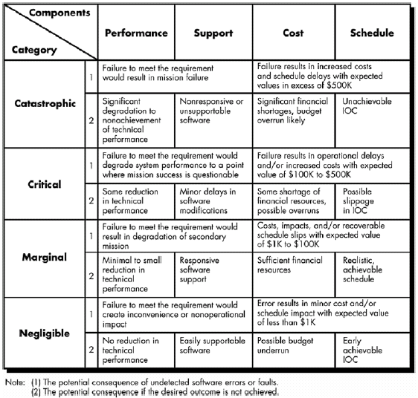
Impact Assessment – Table 1

Slide 8
Risk Management: Reactive vs. Proactive
Reactive
Project team reacts to risks when they occur
Mitigation—plan for additional resources in anticipation of fire fighting
Fix on failure—resource are found and applied when the risk strikes
Crisis management—failure does not respond to applied resources and project is in jeopardy
Proactive
Formal risk analysis is performed
Organization corrects the root causes of risk
TQM concepts and statistical SQA
Examining risk sources that lie
beyond the bounds of the software
Developing the skill to manage
change

Slide 9
Risk Check List
Product size (PS) — risks associated with the overall size of the software to be built or modified.
Business impact (BU) — risks associated with constraints imposed by management or the marketplace.
Customer characteristics (CU) — risks associated with the sophistication of the customer and the developer's ability to communicate with the customer in a timely manner.
Process definition (PR) — risks associated with the degree to which the software process has been defined and is followed by the development organization.
Development Environment (DE) — risks associated with the availability and quality of the tools to be used to build the product.
Technology to be built (TE) — risks associated with the complexity of the system to be built and the "newness" of the technology that is packaged by the system.
Staff size and experience (ST) — risks associated with the overall technical and project experience of the software engineers who will do the work.

Slide 10
Risk Projection & Building a Risk Table
Risk projection, also called risk estimation, attempts to rate each risk in two ways
the likelihood/probability that the risk is real, and
the consequences of the problems associated with the risk, should it occur
The project planner, along with other managers and technical staff, performs four risk projection activities:
Establish a scale that reflects the perceived likelihood of a risk
Delineate the consequences of the risk
Estimate the impact of the risk on the project and the product
Note the overall accuracy of the risk projection so that there will be no misunderstandings

Slide 11
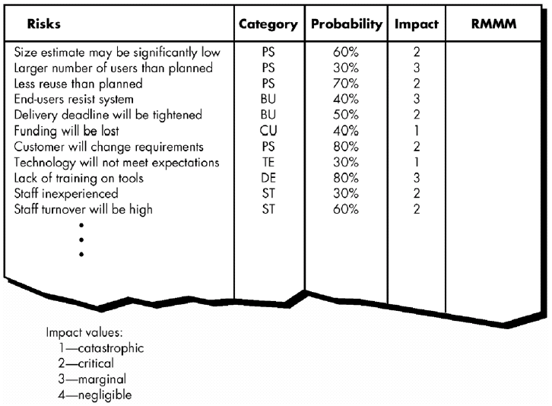
Building Risk Table – Table 2
RMMM = Risk Mitigation, Monitoring and Management

Slide 12
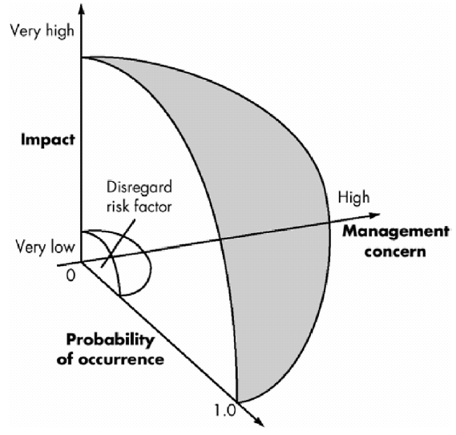
Risk and Management Concern
Risk impact and probability have a distinct influence on management concern

Slide 13
Assessing Risk Impact
The following steps are recommended to determine the overall consequences of a risk:
Determine the average probability of occurrence value for each risk component
Using Table 1 , determine the impact for each component based on the criteria shown
Complete the risk table and analyze the results
The overall risk exposure, RE, is determined using the following relationship:
RE = P x C
where P is the probability of occurrence for a risk, and C is the
cost to the project should the risk occur

Slide 14
Example: Calculating Risk Exposure
Assume that the software team defines a project risk in the following manner:
Risk identification. Only 70 percent of the software components scheduled for reuse will, in fact, be integrated into the application. The remaining functionality will have to be custom developed.
Risk probability. 80% (likely).
Risk impact. 60 reusable software components were planned. If only 70 percent can be used, 18 components would have to be developed from scratch (in addition to other custom software that has been scheduled for development). Since the average component is 100 LOC and local data indicate that the software engineering cost for each LOC is $14.00, the overall cost (impact) to develop the components would be 18 x 100 x 14 = $25,200.
Risk exposure. RE = 0.80 x 25,200 ~ $20,200.

Slide 15
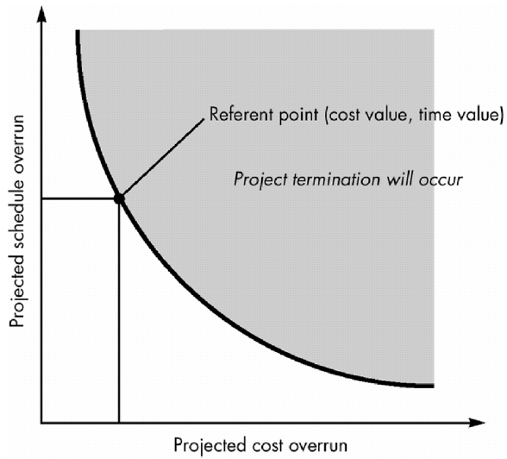
Risk Assessment
For assessment to be useful, a risk referent level must be defined.
In the context of software risk analysis, a risk referent level has a single point, called the referent point or break point, at which the decision to proceed with the project or terminate it (problems are just too great) are equally weighted.

Slide 16
Risk Assessment (cont.)
In reality, the referent level can rarely be represented as a
smooth line on a graph. In most cases, it is a region in which
there are areas of uncertainty; that is, attempting to predict a
management decision based on the combination of referent
values is often impossible. Therefore, during risk assessment, we
perform the following steps:
Define the risk referent levels for the project.
Attempt to develop a relationship between each (r_{i}, l_{i}, x_{i}) and each of the referent levels. (where r_{i} = risk, l_{i} = probability of the risk, and
x_{i} = impact of the risk)
Predict the set of referent points that define a region of termination, bounded by a curve or areas of uncertainty.
Try to predict how compound combinations of risks will affect a referent level.

Slide 17
Risk Decision Tree
A technique that can be used to visualize the risks of alternatives is to build a risk decision tree.
The top-level branch splits based on the alternatives available. The next split is based on the probabilities of events happening. Each leaf node has the risk exposure for that event. The sum of risks exposure for all leafs under a top-level split gives the total risk exposure for that choice.
Example – A friend offers to play one of two betting games with you. Game A is that you toss a coin twice. He pays you $10 if you get two heads. You pay him $2 for each tail you toss. Game B is that you also toss a coin twice, but it costs you $2 to play and he pays you $10 if you get two heads. Which game should you play?

Slide 18
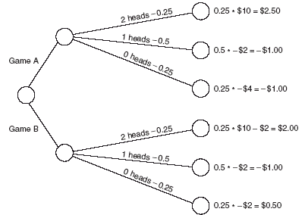
Risk Decision Tree (cont.)
The risk decision tree is shown below. Both games total to $0.50. Thus, each time you play, your average gain is 50 cents. No matter which game you choose.
–

Slide 19
A Framework for Dealing with Risk
Planning for risk includes four steps:
Risk identification – what risks might there be?
Risk analysis and prioritization – which are the most serious risks?
Risk planning – what are we going to do about them?
Risk monitoring – what is the current state of the risk?

Slide 20
Risk identification
Approaches to identifying risks include:
Use of checklists – usually based on the experience of past projects (see previous slides)
Brainstorming – getting knowledgeable stakeholders together to pool concerns
Causal mapping – identifying possible chains of cause and effect

Slide 21
Causal Mapping
The idea here is to get the major stakeholders together and to brainstorm collectively the things that could go wrong. The causes of the problems identified are traced back using the mapping technique which identifies the project factors ( or ‘concept variables’) that people see as being important and the causal links between them. These links can be positive or negative.
Where possible, for each factor, positive and negative aspects are identified e.g. ‘stable…unstable requirements’.

Slide 22
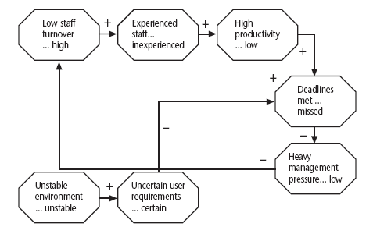
Causal Mapping

Slide 23
Causal Mapping - Interventions
Once a causal map has been drawn up identifying possible negative outcomes and their causes, the map can be modified to introduce policies or interventions which should reduce or mitigate the effects of the negative outcomes.
Often a risk reduction activity can actually introduce new risks. The use of consultants to offset the effects of skill shortages is an example of this. Causal mapping can help identify such adverse side-effects.

Slide 24
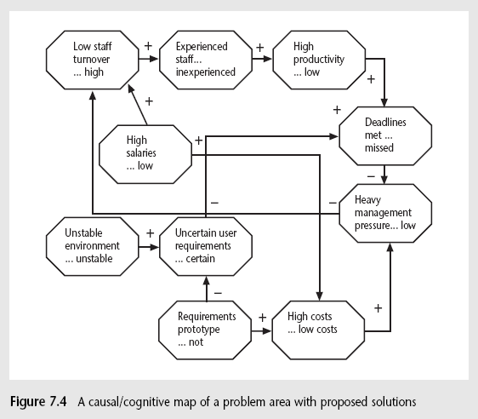
Causal Mapping - Interventions

Slide 25
Boehm’s Top 10 Development Risks
Risk | Risk reduction techniques
Personnel shortfalls | Staffing with top talent; job matching; teambuilding; training and career development; early scheduling of key personnel
Unrealistic time and cost estimates | Multiple estimation techniques; design to cost; incremental development; recording and analysis of past projects; standardization of methods
Developing the wrong software functions | Improved software evaluation; formal specification methods; user surveys; prototyping; early user manuals
Developing the wrong user interface | Prototyping; task analysis; user involvement

Slide 26
Boehm’s Top 10 Development Risks (cont.)
Risk | Risk reduction techniques
Gold plating | Requirements scrubbing, prototyping, design to cost
Late changes to requirements | Change control, incremental development
Shortfalls in externally supplied components | Benchmarking, inspections, formal specifications, contractual agreements, quality controls
Shortfalls in externally performed tasks | Quality assurance procedures, competitive design etc.
Real time performance problems | Simulation, prototyping, tuning
Development technically too difficult | Technical analysis, cost-benefit analysis, prototyping , training

Slide 27
Risk Exposure
Risk Exposure (RE) = (potential damage) x (probability of occurrence)
Ideally
Potential damage: a money value
e.g. a flood would cause $0.5 millions of damage
Probability 0.00 (absolutely no chance) to 1.00 (absolutely certain)
e.g. 0.01 (one in hundred chance)
RE = $0.5m x 0.01 = $5,000
Crudely analogous to the amount needed for an insurance premium
Note: In practice, with project risks, the quantitative approaches are usually impractical and more qualitative approaches are used instead. See the next slide...

Slide 28
Risk Exposure Example
Ref | Hazard | Likelihood | Impact | Risk Exposure
R1 | Changes to requirements specification during coding | 8 | 8 | 64
R2 | Specification takes longer than expected | 3 | 7 | 21
R3 | Significant staff sickness affecting critical path activities | 5 | 7 | 35
R4 | Significant staff sickness affecting non-critical activities | 10 | 3 | 30
R5 | Module coding takes longer than expected | 4 | 5 | 20
R6 | Module testing demonstrates errors or deficiencies in design | 4 | 8 | 32

Slide 29
Qualitative descriptors of Risk probability and associated range values
Probability level | Range
High | Greater than 50% chance of happening
Significant | 30-50% chance of happening
Moderate | 10-29% chance of happening
Low | Less than 10% chance of happening
Managers would be happier identifying an approximate range rather than a precise probability.

Slide 30
Qualitative descriptors of Impact on cost and associated range values
Impact level | Range
High | Greater than 30% above budgeted expenditure
Significant | 20 to 29% above budgeted expenditure
Moderate | 10 to 19% above budgeted expenditure
Low | Within 10% of budgeted expenditure

Slide 31
Problem with Qualitative Approach
Similar tables can be produced for the impact on project duration and on the quality of project deliverables.
The problem with the qualitative approach is how do you combine the judgements about probability and impact – you can’t multiply them together.

Slide 32
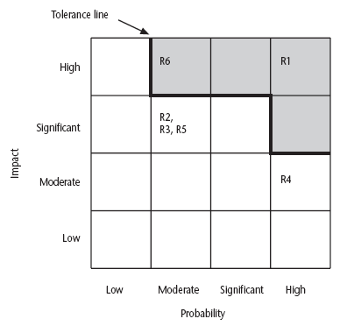
Probability Impact Matrix

Slide 33
Probability Impact Matrix
R1, R2 etc. refer to particular risks. They are located on the grid according to the likelihood and impact ratings that have been allocated to them. A zone around the top right hand corner of the grid can be designated and risks falling within that zone are treated as requiring urgent action.

Slide 34
Risk Planning
Having identified the major risks and allocated priorities, the task is to decide how to deal with them. Risks can be dealt with by:
Risk acceptance
Risk avoidance
Risk reduction
Risk transfer
Risk mitigation

Slide 35
Risk Planning
Risk Acceptance – the cost of avoiding the risk may be greater than the actual cost of the damage that might be inflicted. This is the do-nothing option.
Risk Avoidance – avoid the environment in which the risk occurs e.g. buying an OTS application would avoid a lot of the risks associated with software development e.g. poor estimates of effort.
Risk Reduction – the risk is accepted but actions are taken to reduce its likelihood e.g. prototypes ought to reduce the risk of incorrect requirements.
Risk Transfer – the risk is transferred to another person or organization. The risk of incorrect development estimates can be transferred by negotiating a fixed price contract with an outside software supplier.
Risk Mitigation – tries to reduce the impact if the risk does occur e.g. taking regular back-ups of data storage would reduce the impact of data corruption. Mitigation is closely associated with contingency planning.

Slide 36
Risk Reduction Leverage (RRL)
Risk Reduction Leverage (RRL) = (RE_{before}- RE_{after})/(cost of risk reduction)
RE_{before} is risk exposure before risk reduction e.g. 1% chance of a fire causing $200k damage
RE_{after} is risk exposure after risk reduction e.g. fire alarm costing $500 reduces probability of fire damage to 0.5%
RRL = { (1% of $200k) – (0.5% of $200k) } / $500 = 2
RRL > 1.00, therefore worth doing
Note: If you think in terms of the analogy to insurance. An insurance company might reduce the fire insurance premium from $2k to $1k on condition that a fire alarm is installed. The insured would save $1k a year by investing $500 so it would be worth doing.
Note: Cost-effectiveness of a risk reduction action can be assessed by RRL

Slide 37
Using PERT to evaluate the effects of uncertainty
Three estimates are produced for each activity
Most likely time (m) –the time we would expect the task to take normally
Optimistic time (a) –the shortest time could be realistically be expected
Pessimistic time (b) –worst possible time
‘Expected time’ t_{e} = (a + 4m +b) / 6
‘Activity standard deviation’ s = (b – a)/6

Slide 38
A chain of activities
Task A
Task B
Task C
Task | a | m | b | t_{e} | s
A | 10 | 12 | 16 | ? | ?
B | 8 | 10 | 14 | ? | ?
C | 20 | 24 | 38 | ? | ?
Can you fill the missing gaps?

Slide 39
A chain of activities
For Task A, t_{e} = (10+ (12 x 4) + 16)/ 6 = 12.66, s = (16-10)/6 i.e. 1
For Task B, t_{e} = (8 + (10 x 4) + 14)/ 6 = 10.33, s = (14-8)/6 i.e. 1
For Task C, t_{e} = (20 + (24 x 4) + 38)/6 = 25.66, s = (38-20)/6 i.e. 3

Slide 40
A chain of activities (cont.)
What would be the expected duration of the chain A + B + C?
Answer: 12.66 + 10.33 + 25.66 = 48.65
What would be the standard deviation for
A + B+ C?
Answer: Square root of (1² + 1² + 3²) = 3.32

Slide 41
Expected Times and Standard Deviation
Activity Durations in (weeks)
Activity | Optimistic | Most likely | Pessimistic | Expected | Standard deviation
 | (a) | (m) | (b) | ( t_{e} ) | (s)
A | 5 | 6 | 8 | 6.17 | 0.50
B | 3 | 4 | 5 | 4.00 | 0.33
C | 2 | 3 | 3 | 2.83 | 0.17
D | 3.5 | 4 | 5 | 4.08 | 0.25
E | 1 | 3 | 4 | 2.83 | 0.50
F | 8 | 10 | 15 | 10.50 | 1.17
G | 2 | 3 | 4 | 3.00 | 0.33
H | 2 | 2 | 2.5 | 2.08 | 0.08

Slide 42
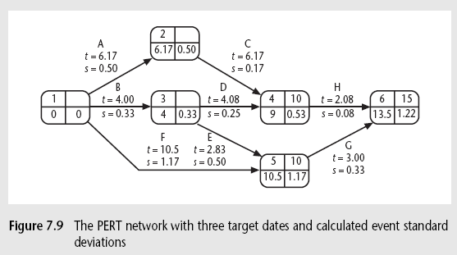
PERT Network
X
t = 2.83
Figure 7.7 @ page 179 (5th edition book)

Slide 43
Assessing the likelihood of meeting a target
Say the target for completing A+B+C was 52 days (T)
Calculate the z value, thus z = (T – t_{e} )/s
In this example z = (52 – 48.65)/3.32 i.e. 1.01
Look up in table of z values ➔ see next slide

Slide 44
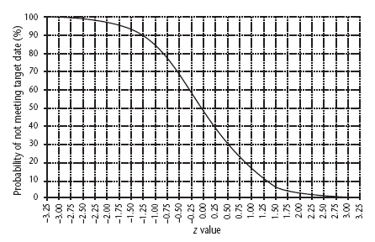
Graph of z values
There is about a 17% chance of not meeting the target of 52 days.

Slide 45
Critical chain approach
One problem with estimates of task duration:
Estimators add a safety zone to estimate to take account of possible difficulties
Developers work to the estimate + safety zone, so time is lost
No advantage is taken of opportunities where tasks can finish early – and provide a buffer for later activities
Note: Developers will tend to start activities as late as is compatible with meeting the target date as they often have other urgent work to be getting on with in the mean time.

Slide 46
Critical chain approach (cont.)
One answer to this:
Base targets on midpoints (i.e. t_{e})
Accumulate 50% of the safety zones (between t_{e} and b) into a buffer at the end of the project
Work backwards and start all activities at their latest start dates
During project execution use ‘relay race’ model
Note:
This approach means that the ‘safety buffer’ in the estimate for an activity is moved from the individual developer to the project as a whole.
The ‘relay race’ principle is that the project manager makes sure that team members are ready to immediately start dependent activities as soon as the preceding activity is finished.

Slide 47
Risk Due to Product Size
Attributes that affect risk:
estimated size of the product in LOC or FP?
estimated size of product in number of programs, files, transactions?
percentage deviation in size of product from average for previous products?
size of database created or used by the product?
number of users of the product?
number of projected changes to the requirements for the product? before delivery? after delivery?
amount of reused software?

Slide 48
Risk Due to Business Impact
Attributes that affect risk:
effect of this product on company revenue?
visibility of this product by senior management?
reasonableness of delivery deadline?
number of customers who will use this product
interoperability constraints
sophistication of end users?
amount and quality of product documentation that must be produced and delivered to the customer?
governmental constraints
costs associated with late delivery?
costs associated with a defective product?

Slide 49
Risks Due to the Customer
Questions that must be answered:
Have you worked with the customer in the past?
Does the customer have a solid idea of requirements?
Has the customer agreed to spend time with you?
Is the customer willing to participate in reviews?
Is the customer technically sophisticated?
Is the customer willing to let your people do their job—that is, will the customer resist looking over your shoulder during technically detailed work?
Does the customer understand the software engineering process?

Slide 50
Risks Due to Process Maturity
Questions that must be answered:
Have you established a common process framework?
Is it followed by project teams?
Do you have management support for software engineering?
Do you have a proactive approach to SQA?
Do you conduct formal technical reviews?
Are CASE tools used for analysis, design and testing?
Are the tools integrated with one another?
Have document formats been established?

Slide 51
Technology Risks
Questions that must be answered:
Is the technology new to your organization?
Are new algorithms, I/O technology required?
Is new or unproven hardware involved?
Does the application interface with new software?
Is a specialized user interface required?
Is the application radically different?
Are you using new software engineering methods?
Are you using unconventional software development methods, such as formal methods, AI-based approaches, artificial neural networks?
Are there significant performance constraints?
Is there doubt the functionality requested is "do-able?"

